Slide 1

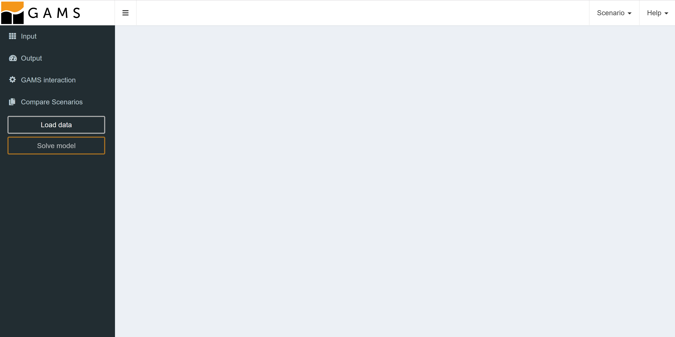
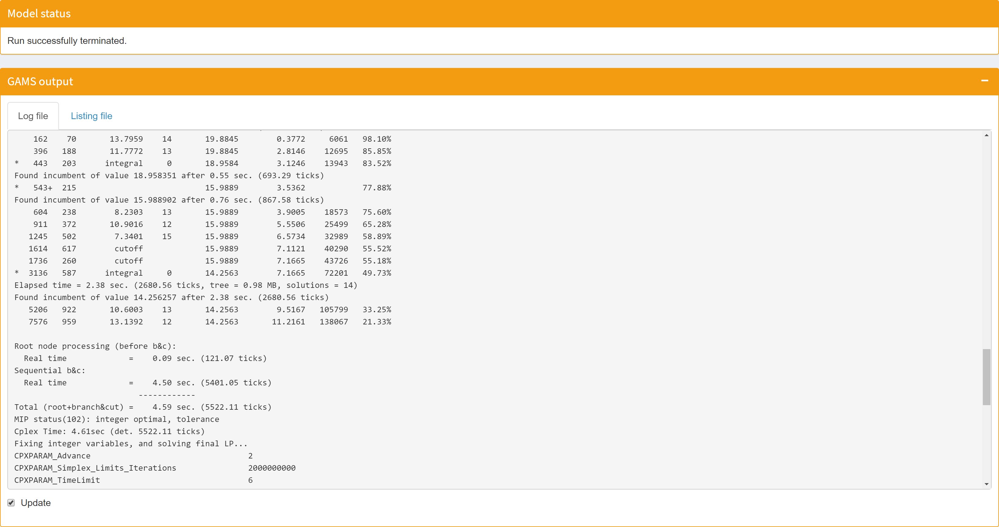
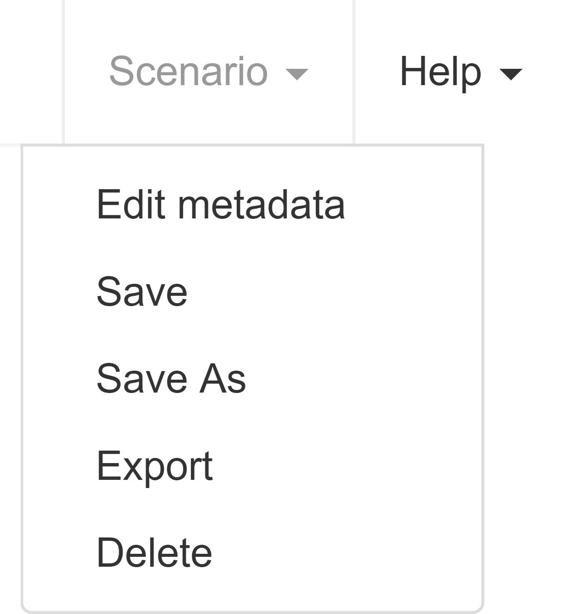
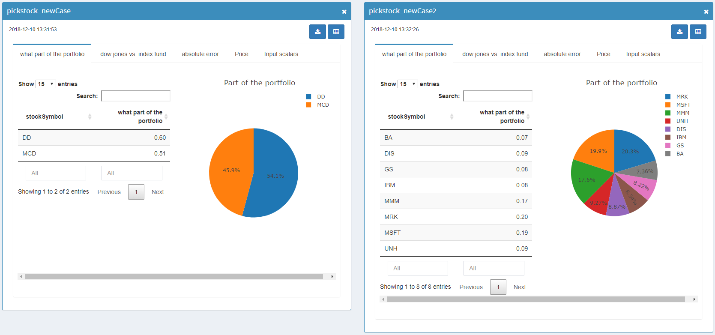
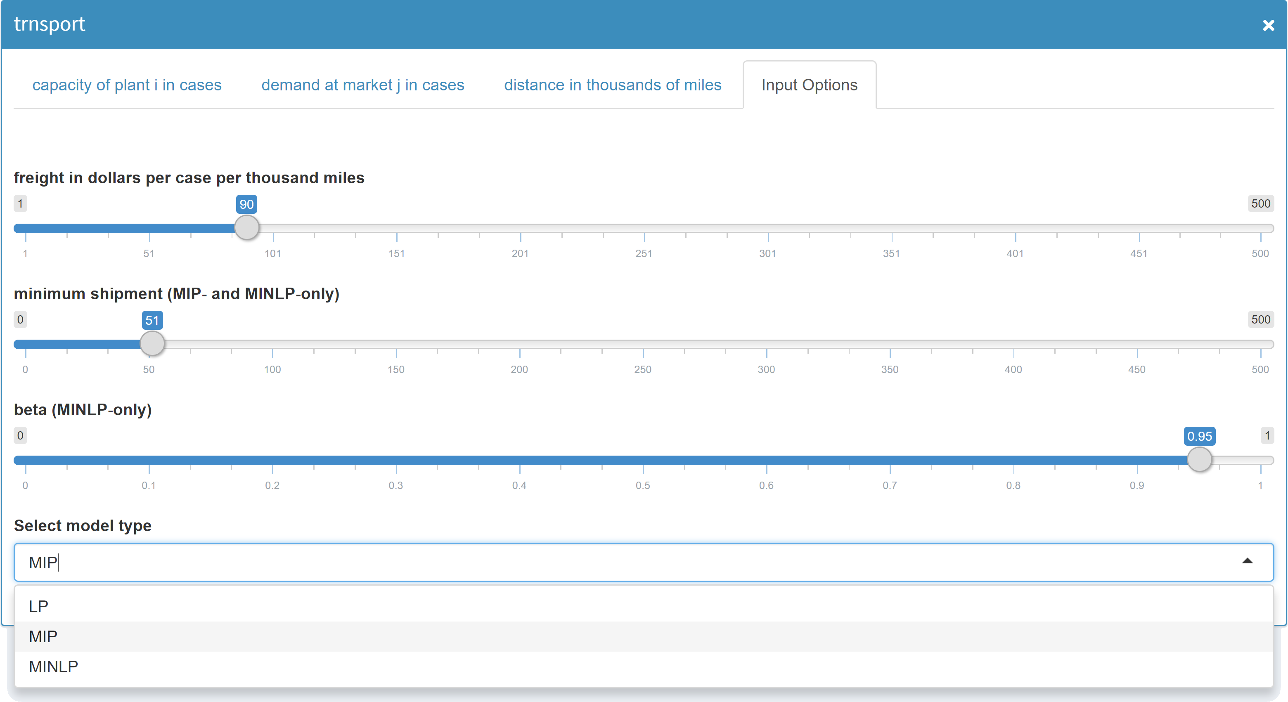
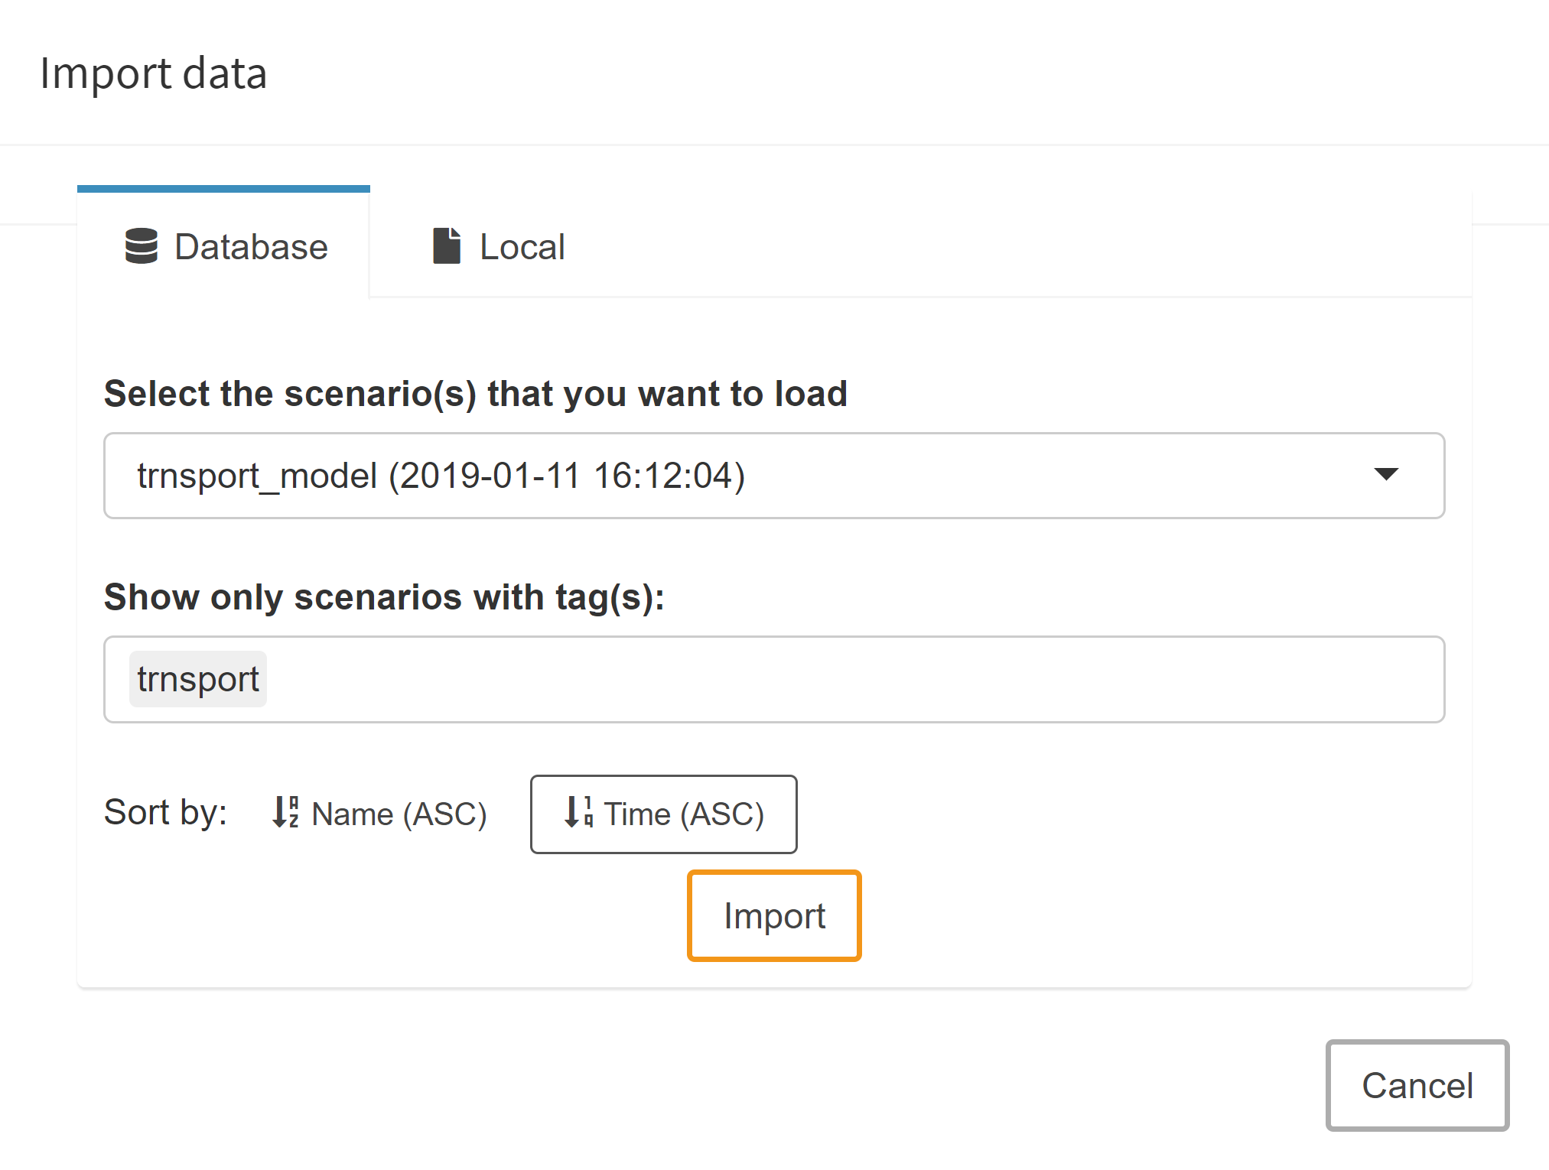
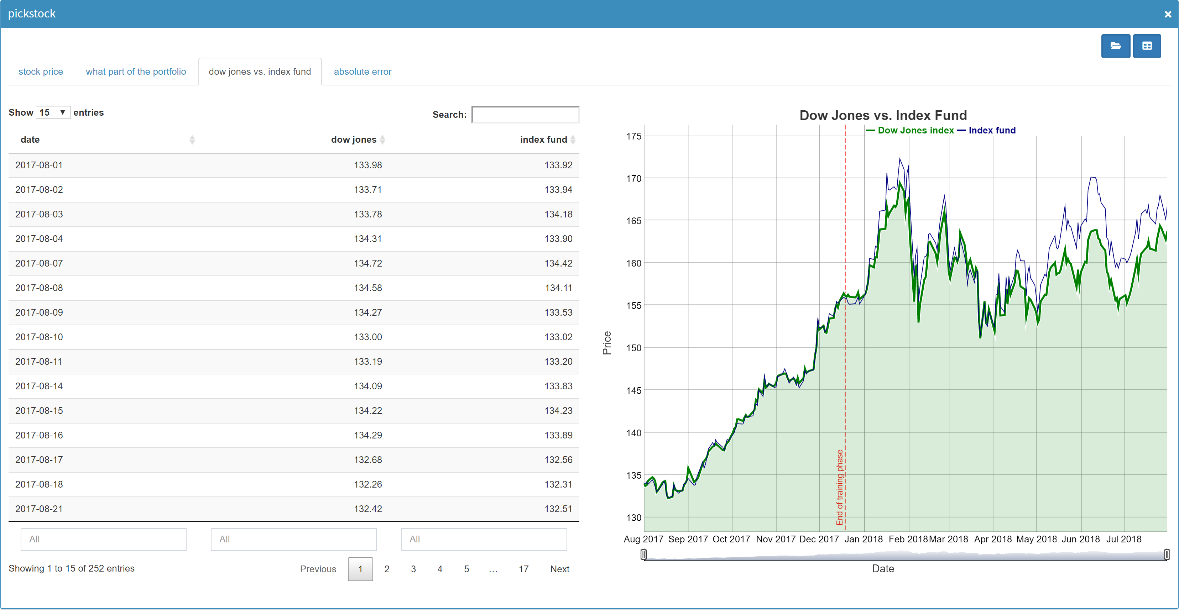
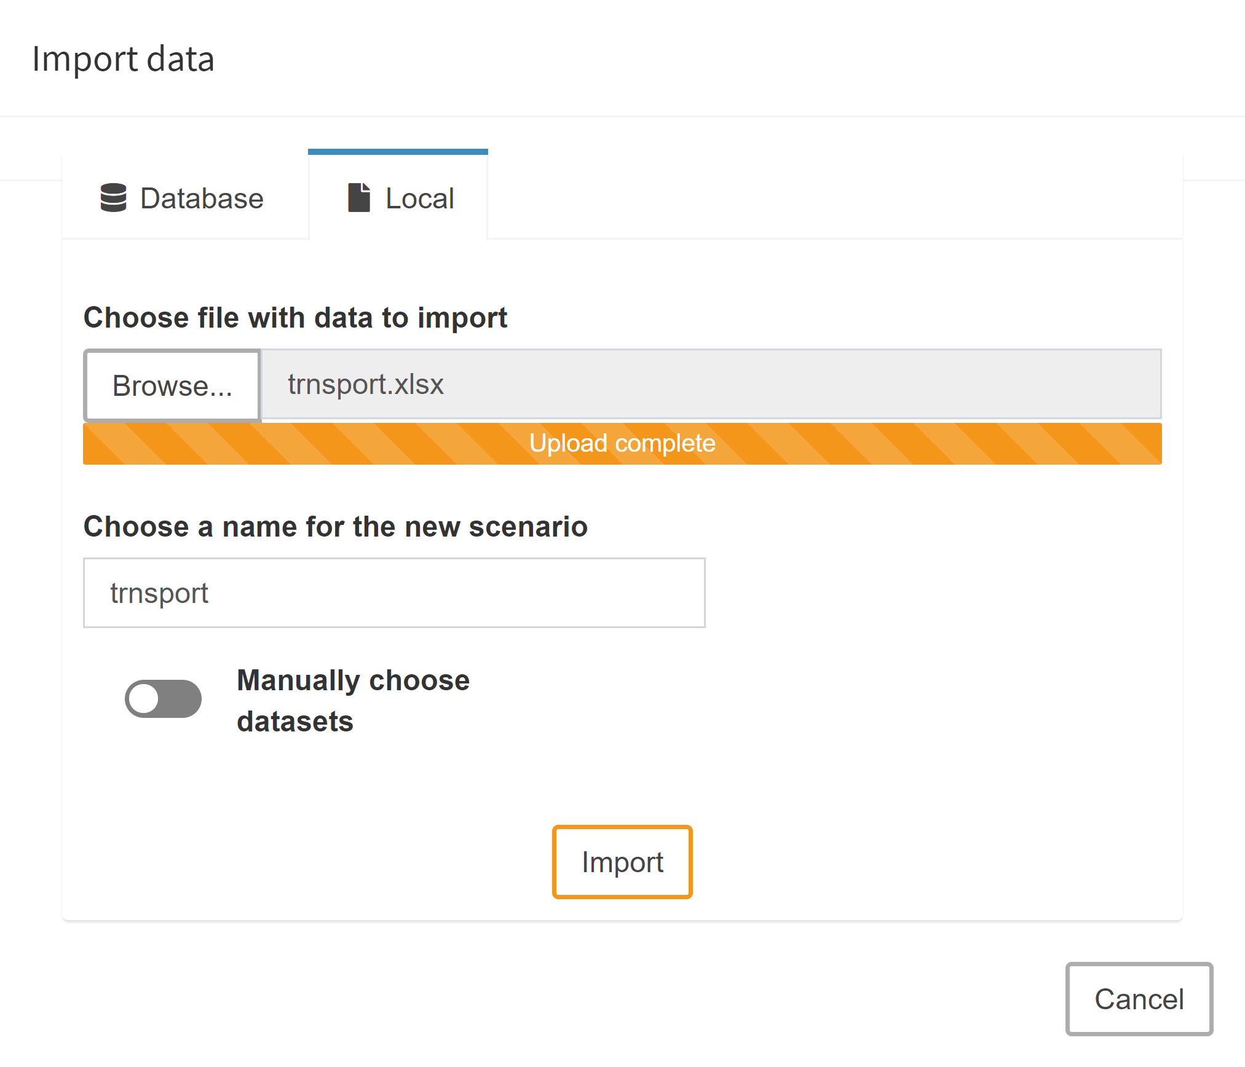
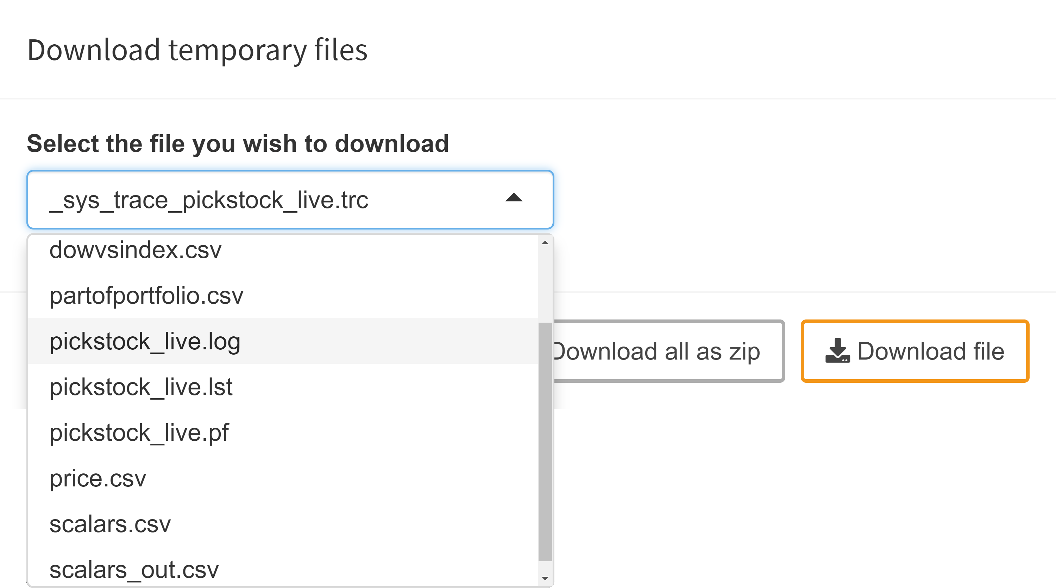
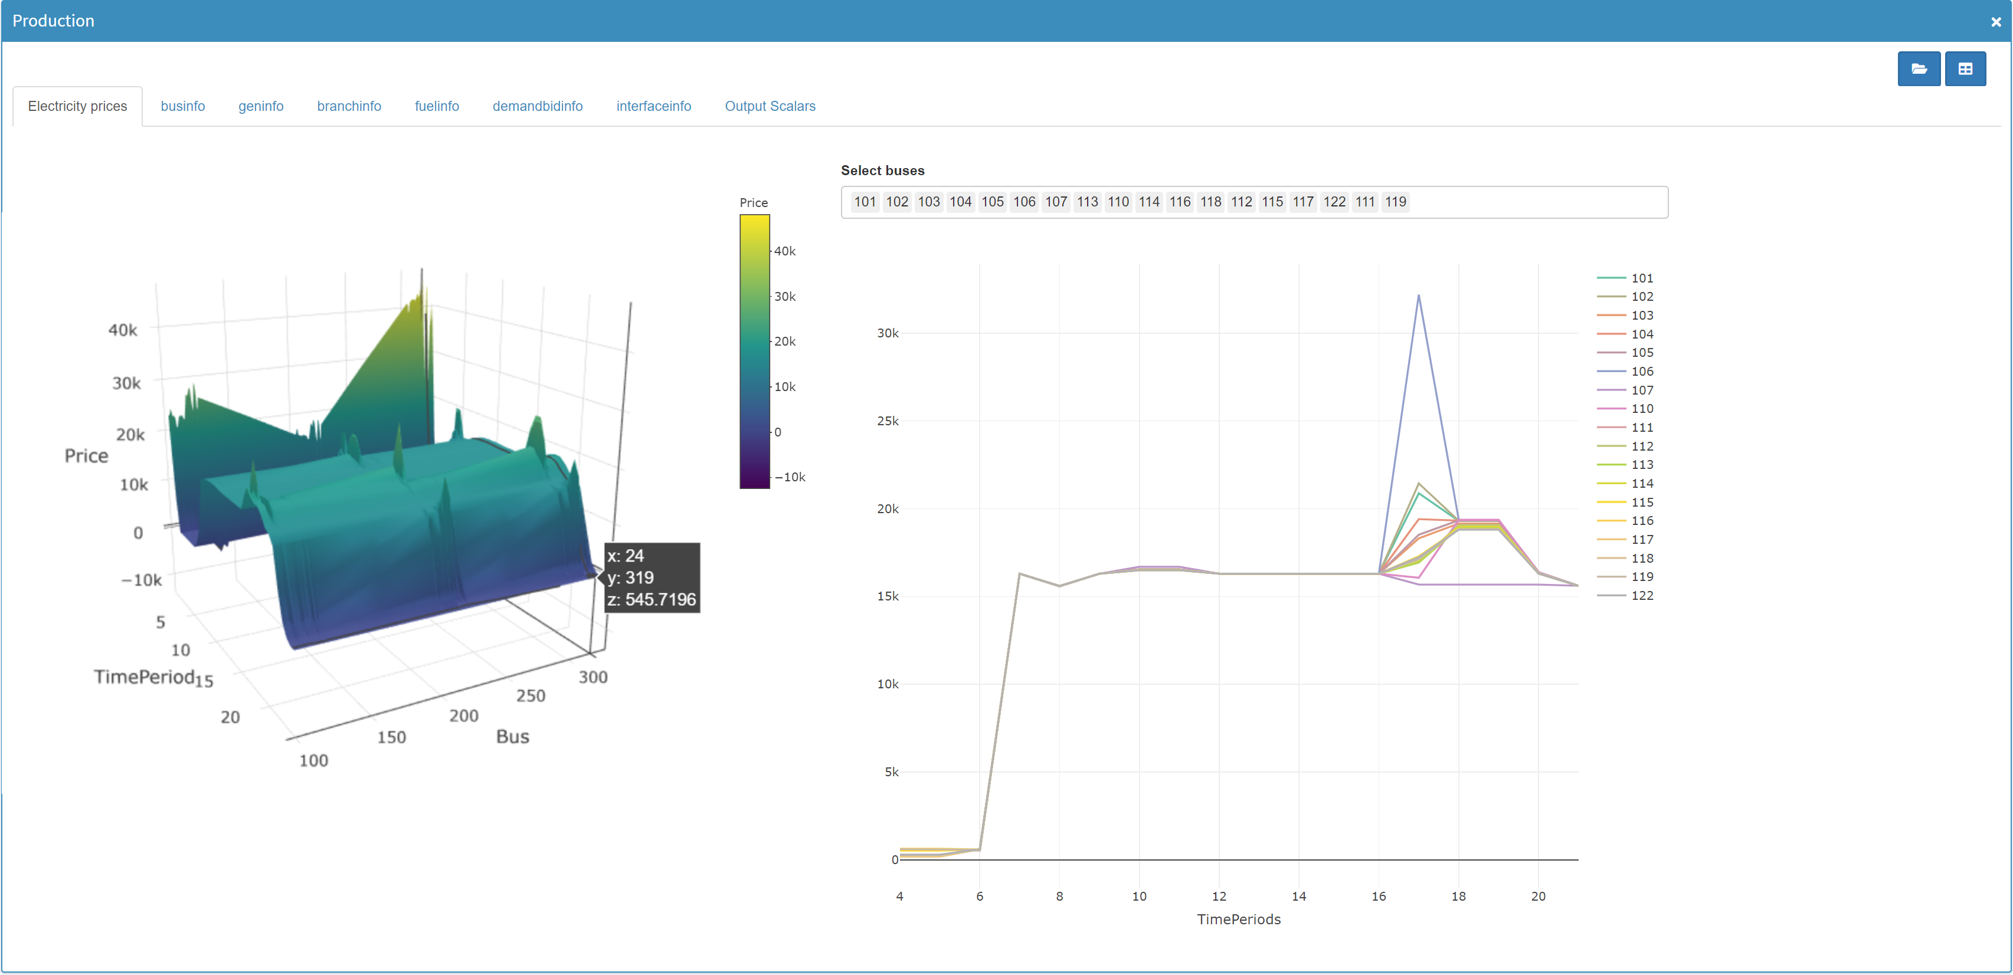
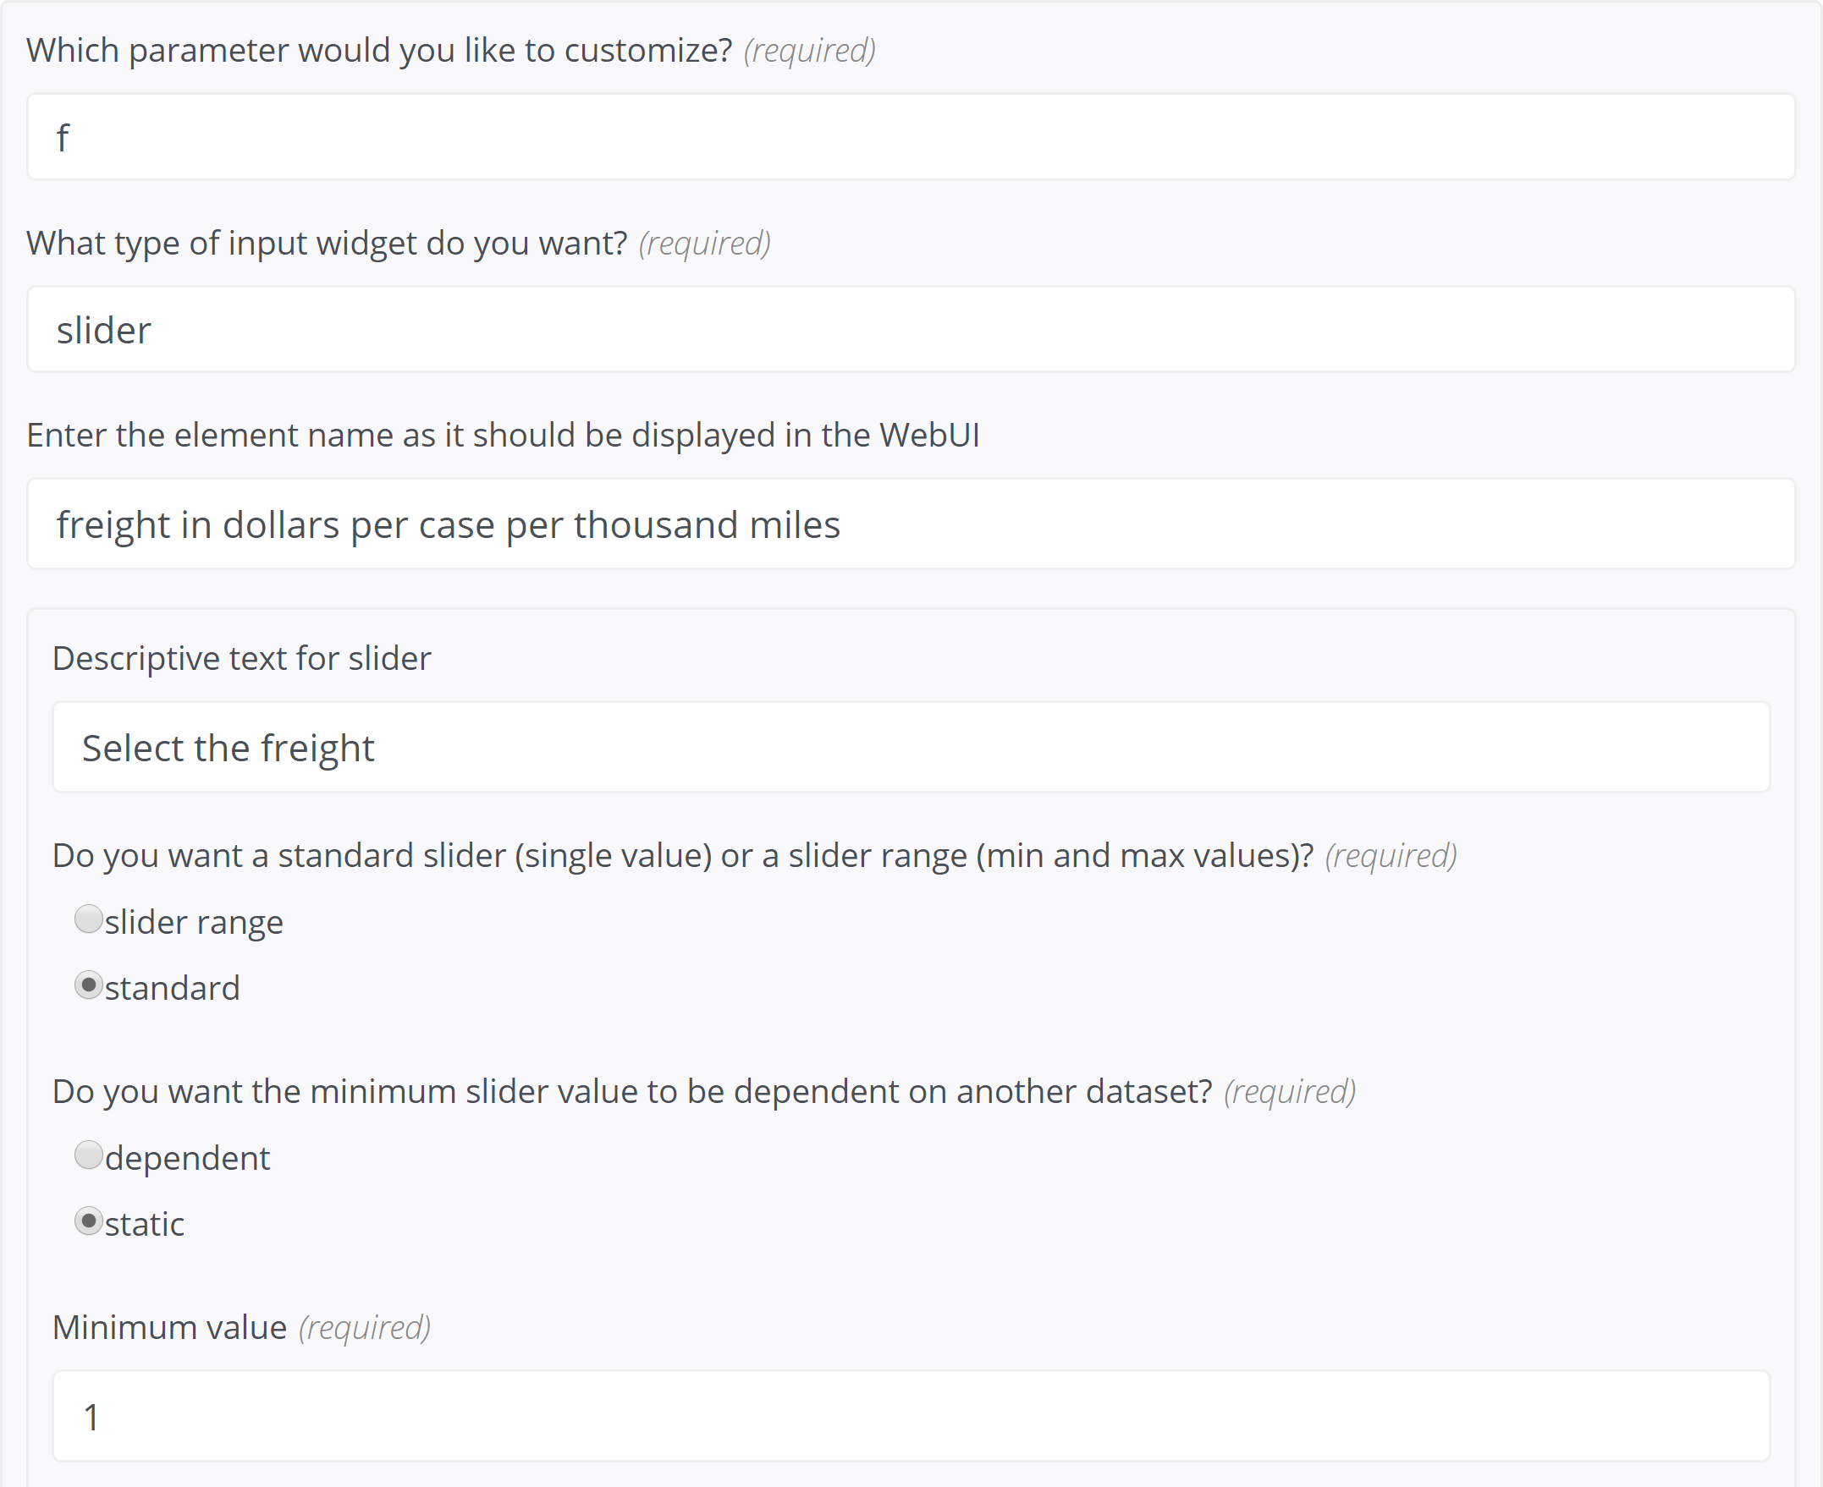
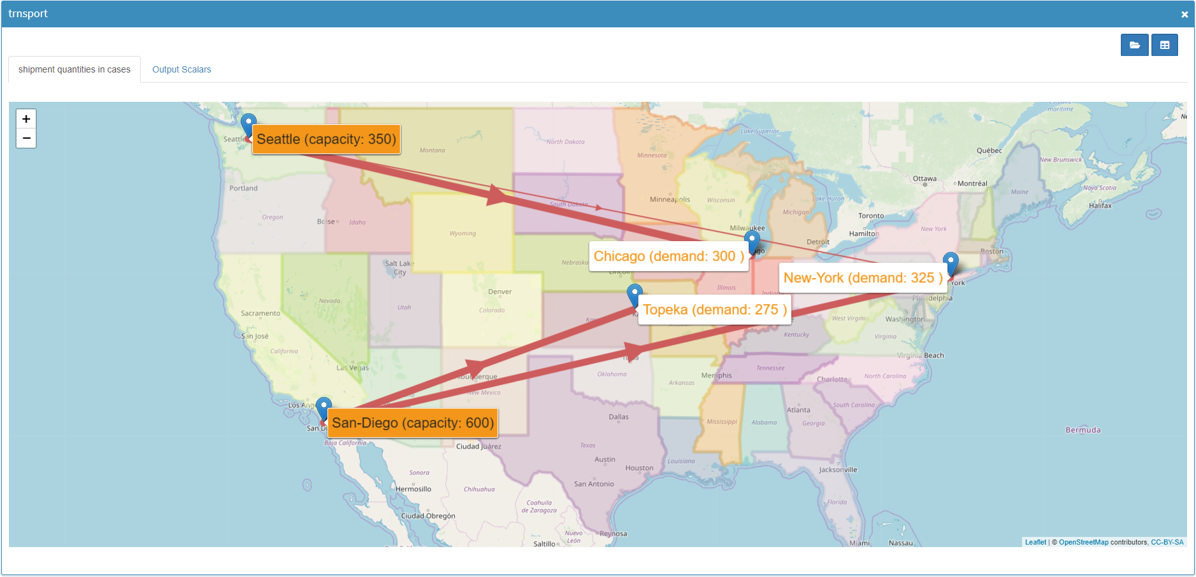
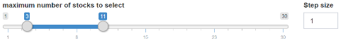
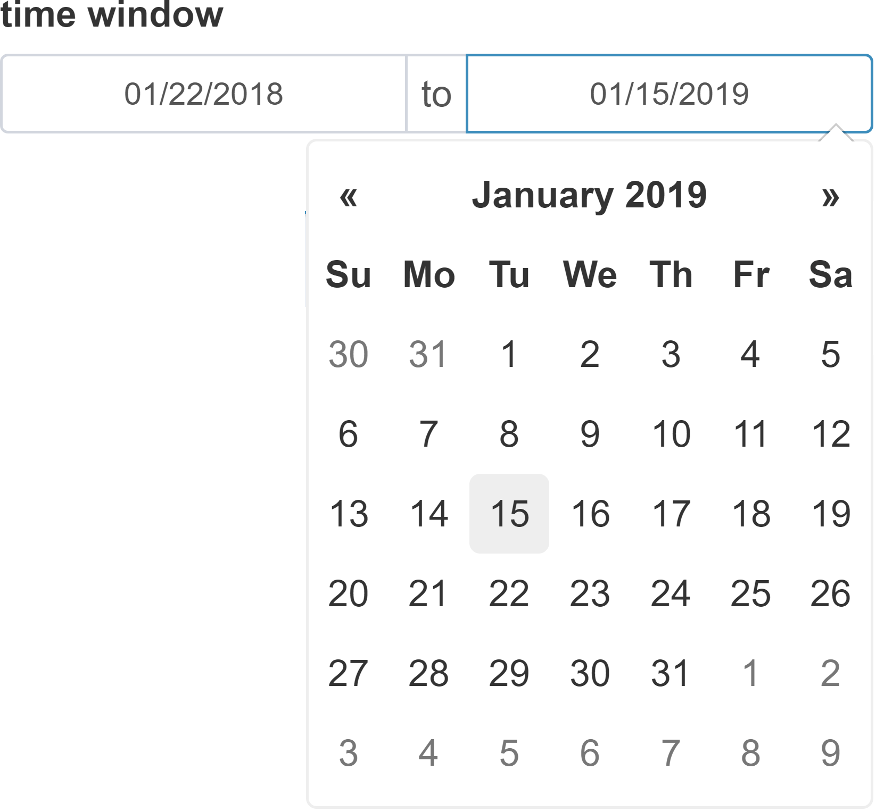
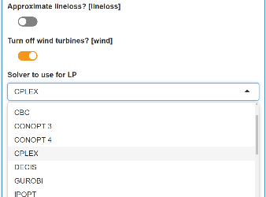
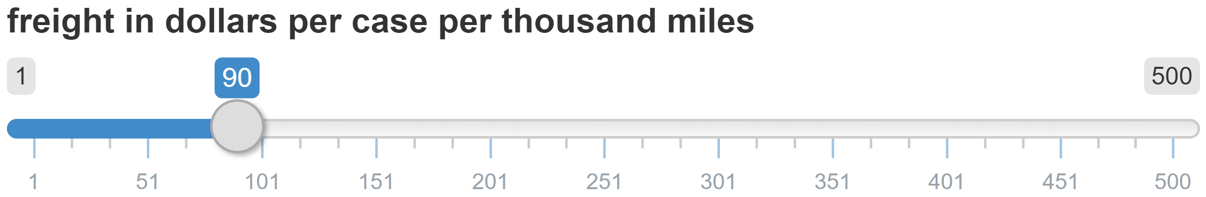
MIRO || cheat sheet
GAMS interaction
Compare Scenarios
Direct access to GAMS output files
Compare scenarios from the database in split screen and tab-view
Basics:
Customizable Logo
Hide Sidebar
Model status message
Log file
Listing (lst) file
Download scenario data (Excel)
Close scenario
Documentation
The GAMS WebUI is a graphical user interface (GUI) for GAMS models that runs inside your browser.
Scenario management
Key features:
Save / edit / delete / export scenario data
Quick & automated deployment of GAMS models
Data visualization with powerful graphics
Sophisticated generation, processing, evaluation & storing of scenario data
Intuitive planning without GAMS knowledge
Easy to use & comfortable working environment
Switch between Graphic and raw data
Download temporary files
All files of the working directory
Solution reports
GAMS Log & Lst file
[…]
Input data tabs
Dropdown menu
Slider
Table page navigation
Output data tabs
Input
Output
Visualization & configuration of input data for the next calculations
Visualization of results
How to get there
Annotating the GAMS model
Configuration
Custom Graphics
Flag input data with $onExternalInput / $offExternalInput tags
Flag output data with $onExternalOutput / $offExternalOutput tags
Include the file webui (GAMS include library) at the end of the model
WebUI configuration & customization via JSON file config.json – you can generate JSON with the configuration generator
Input widgets:
Table
Slider / slider range
(Multi) dropdown menu
Date (range) selector
Checkbox
Textbox
[…]
An R API provides extensive visualization options (custom renderers).
General appearance
Input widgets
Graphics
Functionality
Language
[…]
[…]
$onExternalInput
Parameters a(i) 'capacity of plant i in cases' / seattle 350
san-diego 600 /
Scalar f 'freight in dollars/case per 1000 miles' /90/ ;
$offExternalInput
[…]
$onExternalOutput
Variables x(i,j) 'shipment quantities in cases'
z 'total transportation costs in 1000$’ ;
Scalar f 'freight in dollars per case per thousand miles' / 90 /
$offExternalOutput
[…]
Solve transport using lp minimizing z;
$libInclude webui
Configuration Generator
Graphics (pre-implemented):
Data table
Pie chart
Bar chart
Line chart
Scatter plot
Histogram
Pivot table
{
"inputWidgets": {
"f": {
"widgetType": "slider",
"alias": “freight in dollars per case per thousand miles",
"label": "Select the freight",
"min": 1,
"max": 500,
"default": 90,
"step": 1
}
}
}
Generated JSON
Resulting Input widget

Slide 2

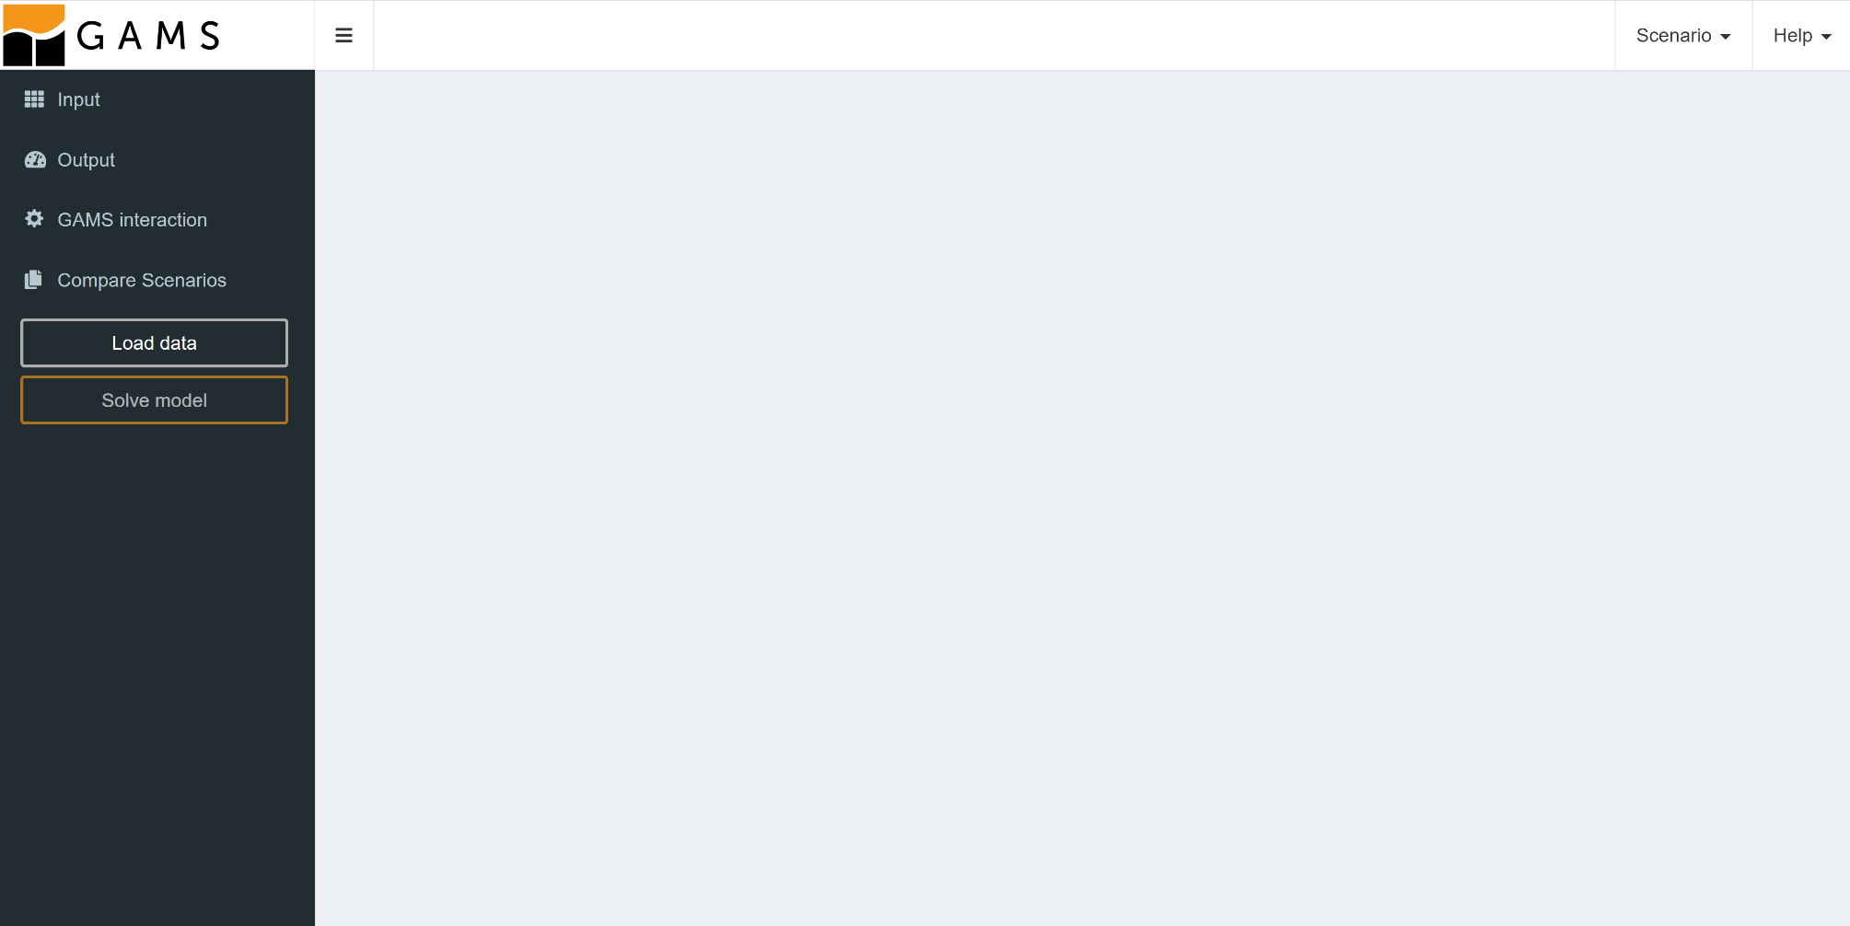
Basics:
The Hypercube mode
Key features:
Creation & analysis of performance statistics
Analysis of the parameter range of a model

Slide 3

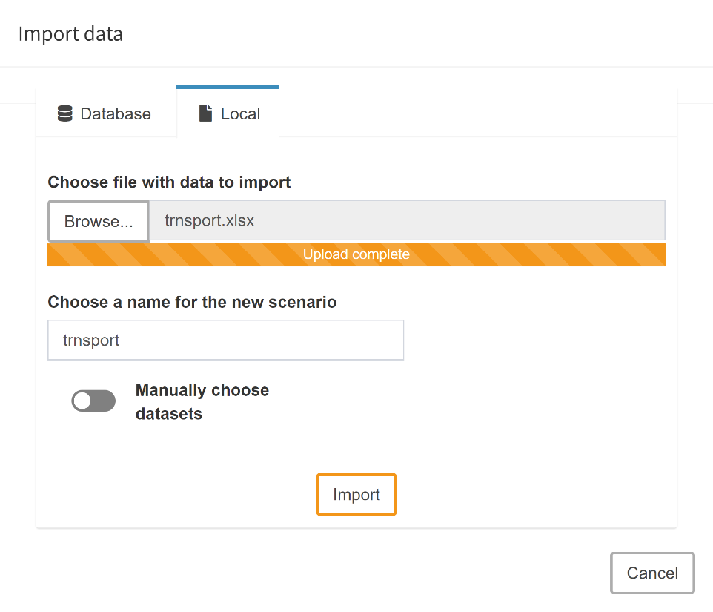

Slide 4
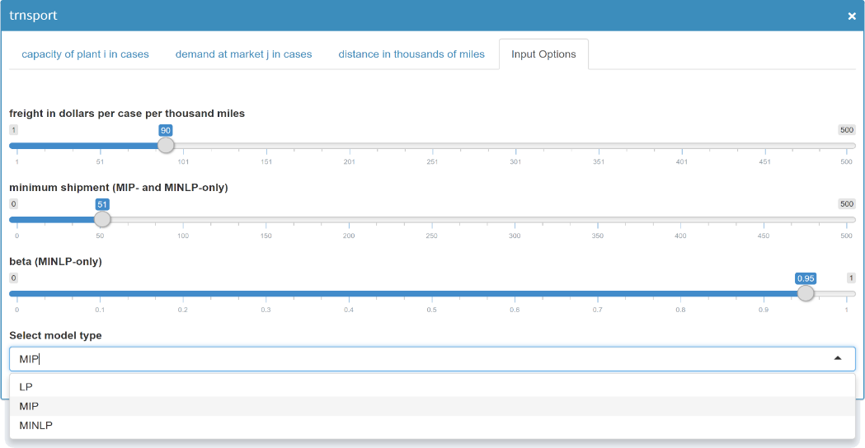
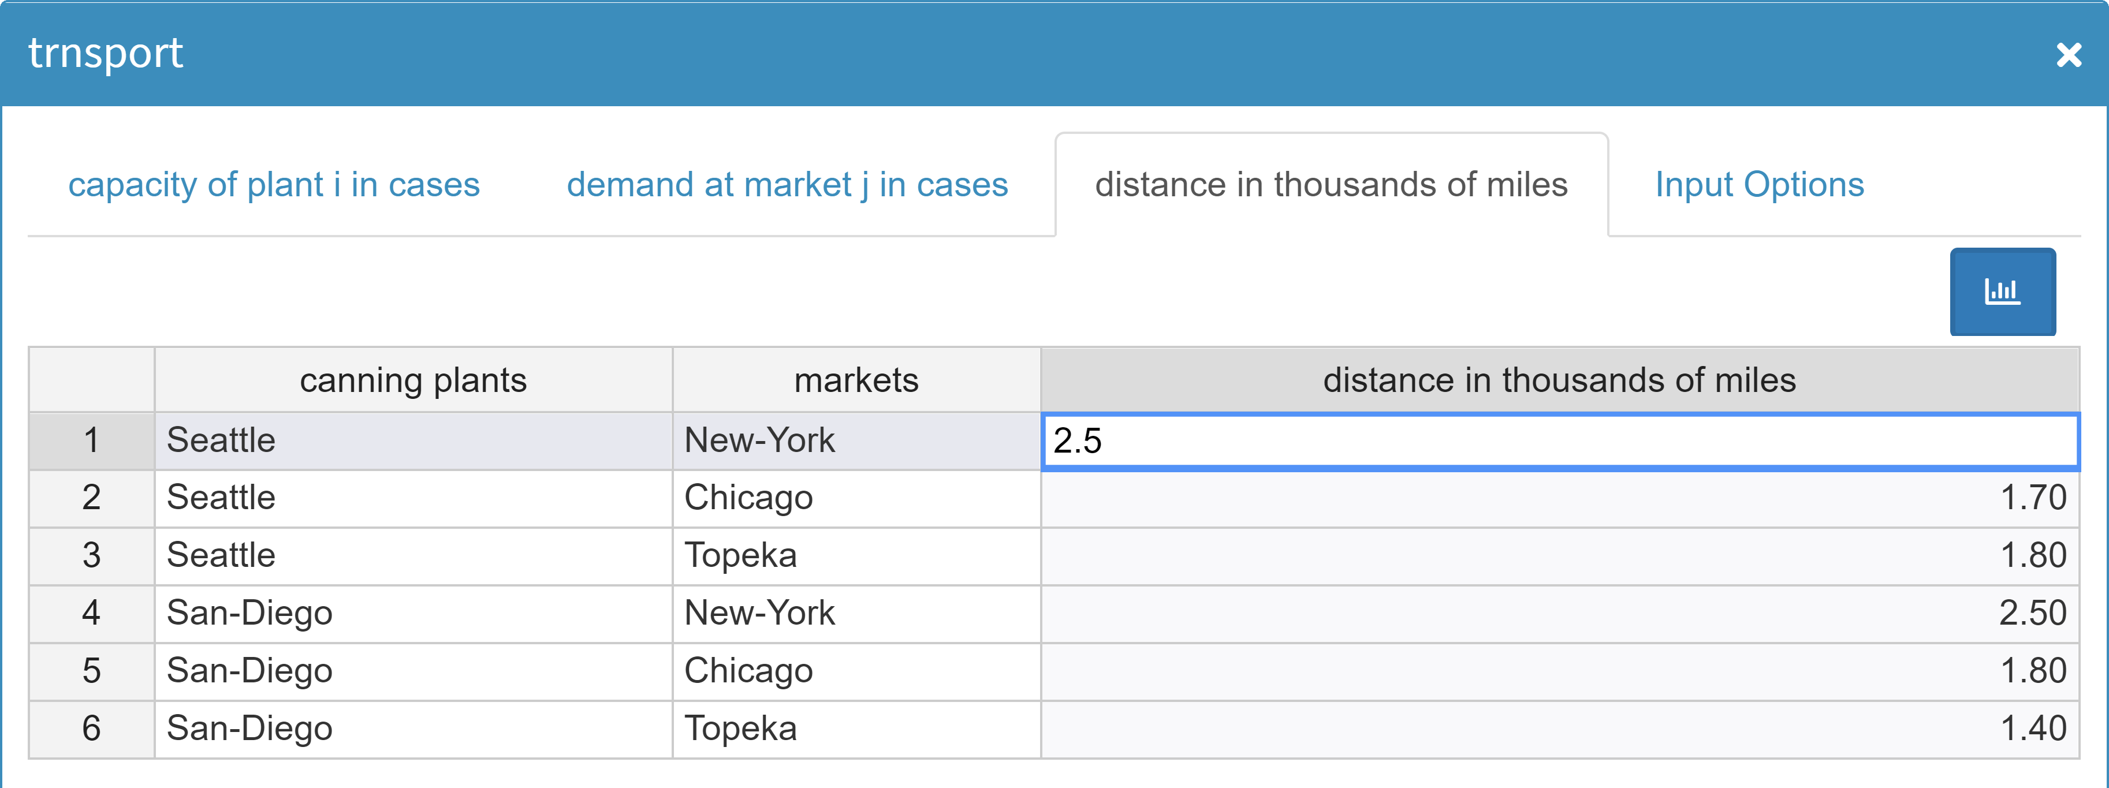

Slide 5
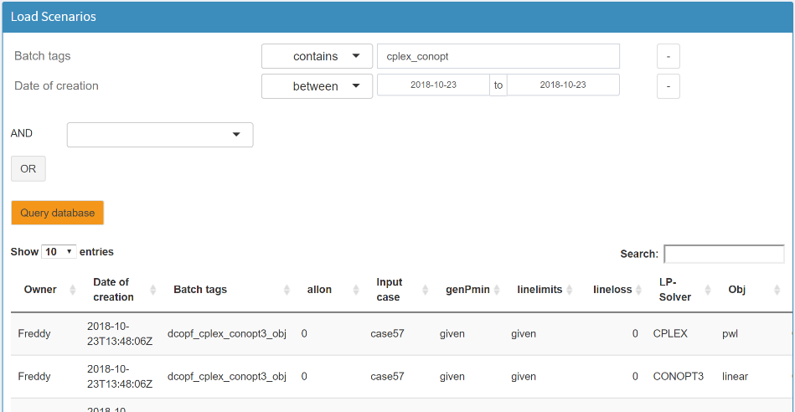

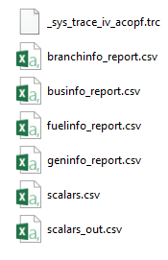
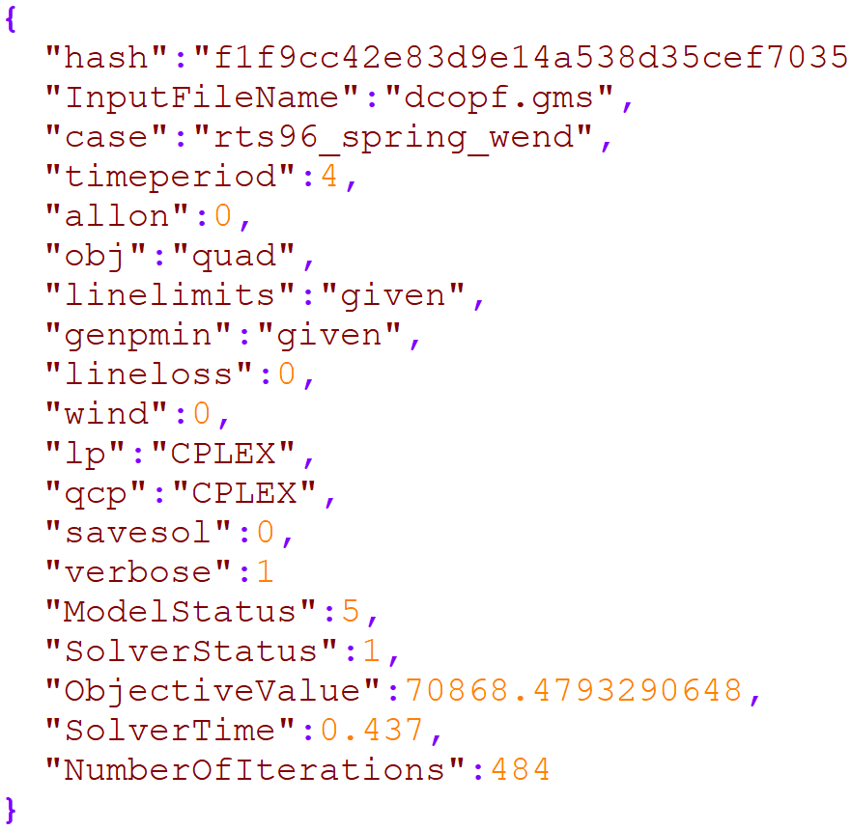

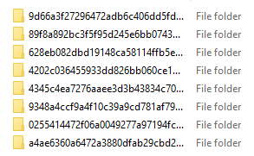
Analyses – Example (external)
Download scenario data for external analyses
Contains model input & output (incl. scalar in- & output data)

Slide 6
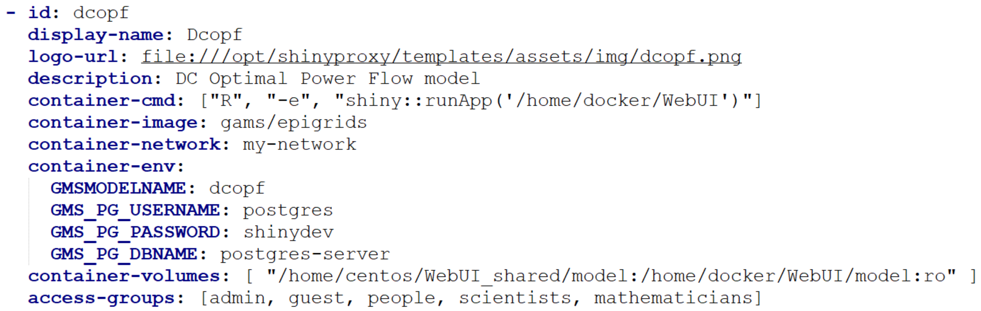
Identifier of the application
URL to logo for the application (image name has to be the same as id)
Name that will be displayed
Name of GAMS model file (without ‘.gms’)

